Slide 1


“Stop Phishing Before It Hooks You.”
هاكاثون عرابة 2025: نبتكر من أجل التأثير المجتمعي
Team 16

Slide 2
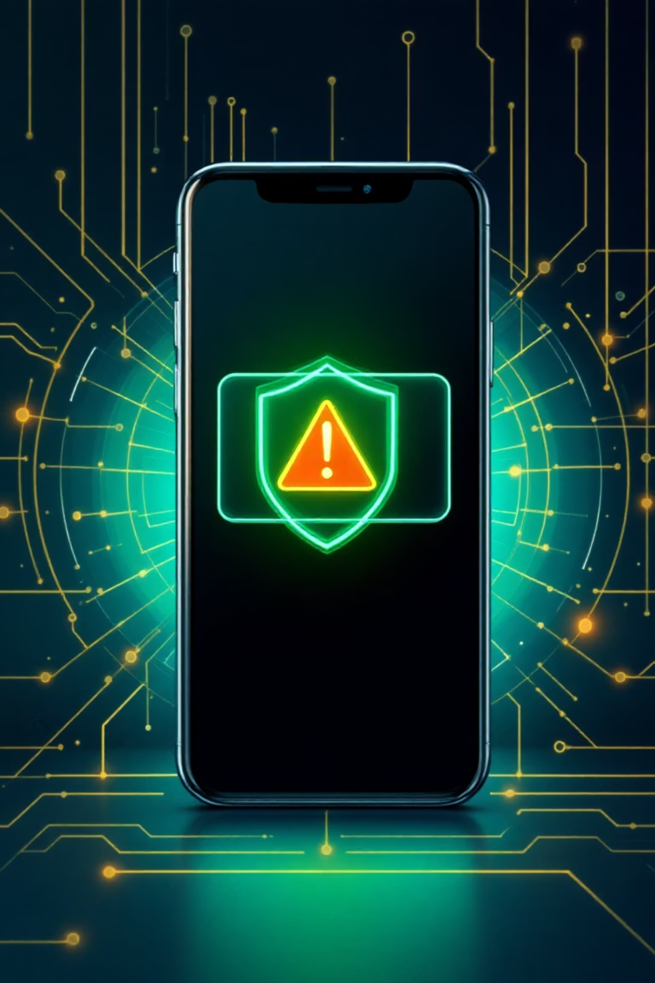
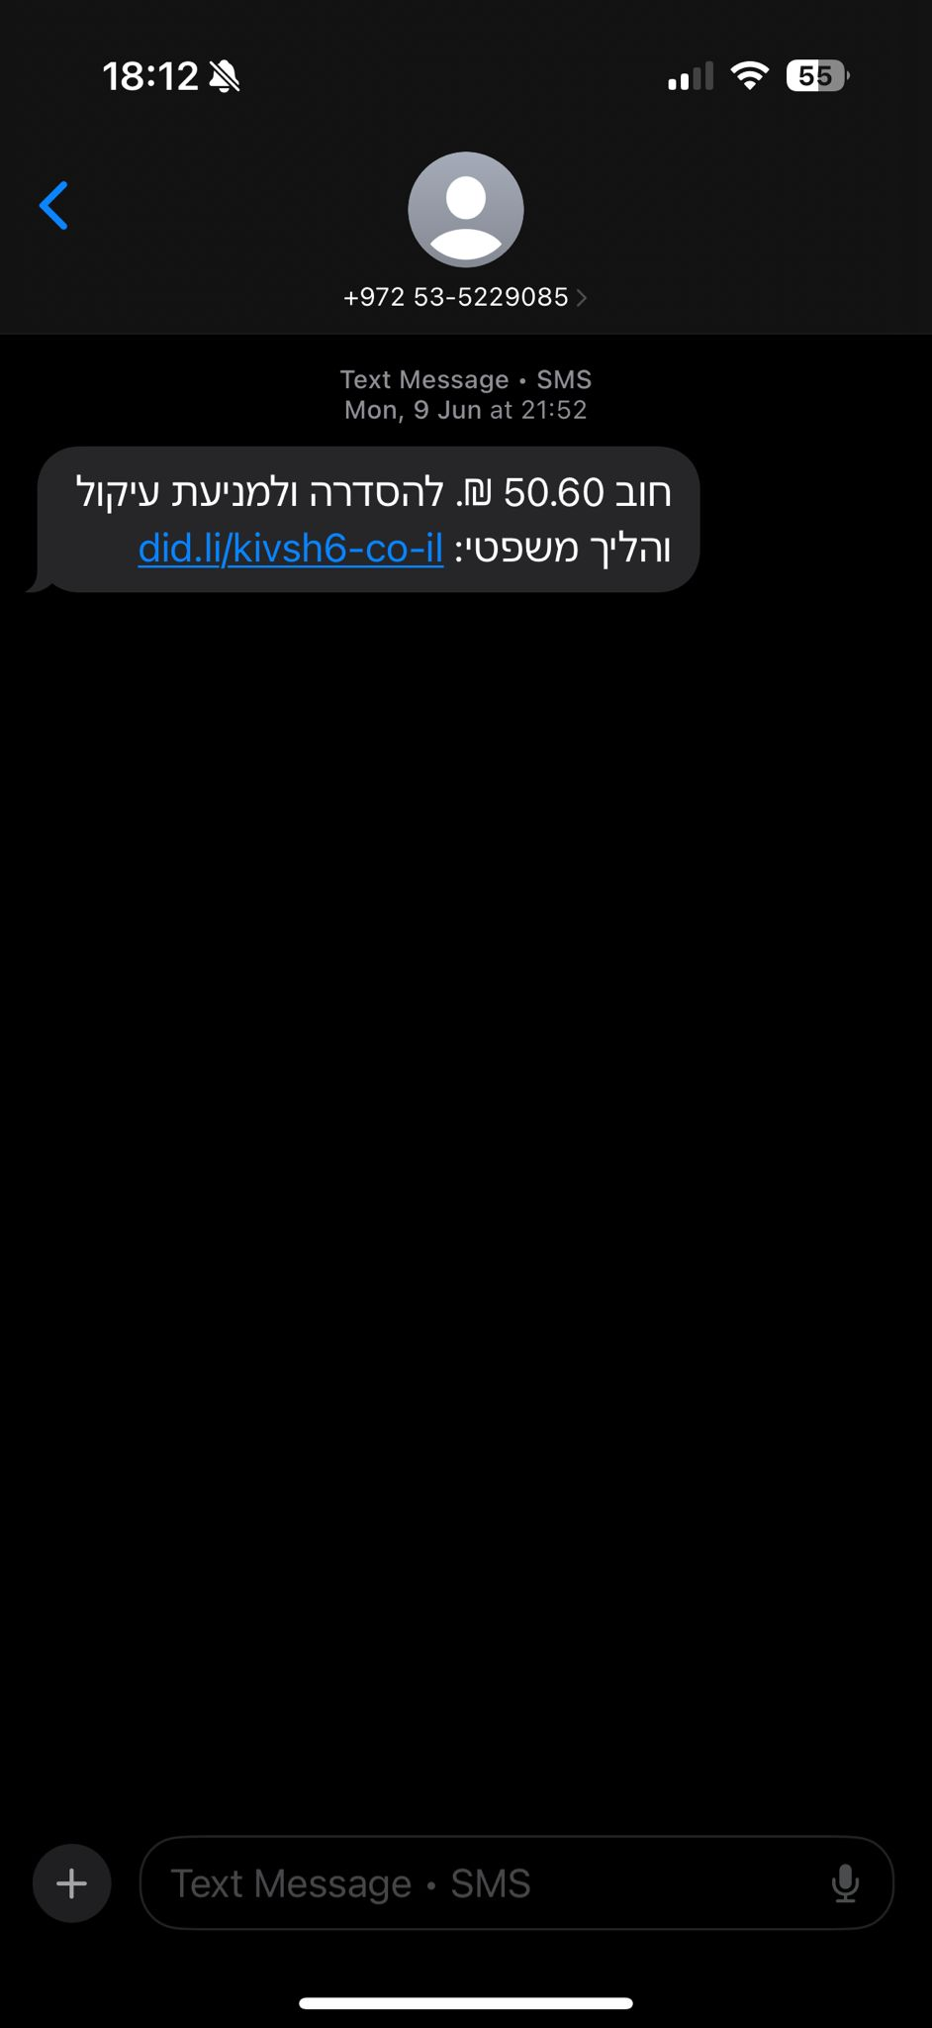
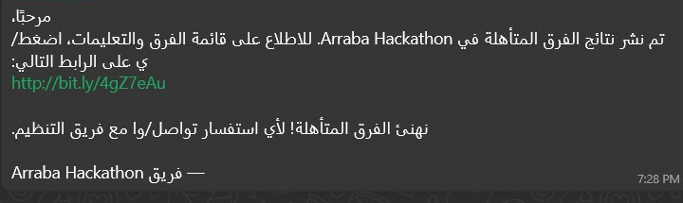
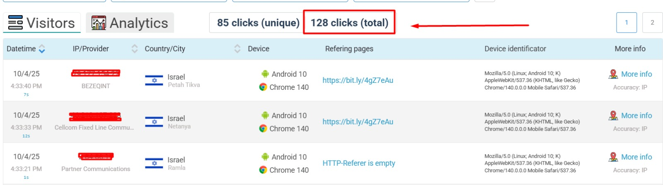
The Phishing Problem

Slide 3
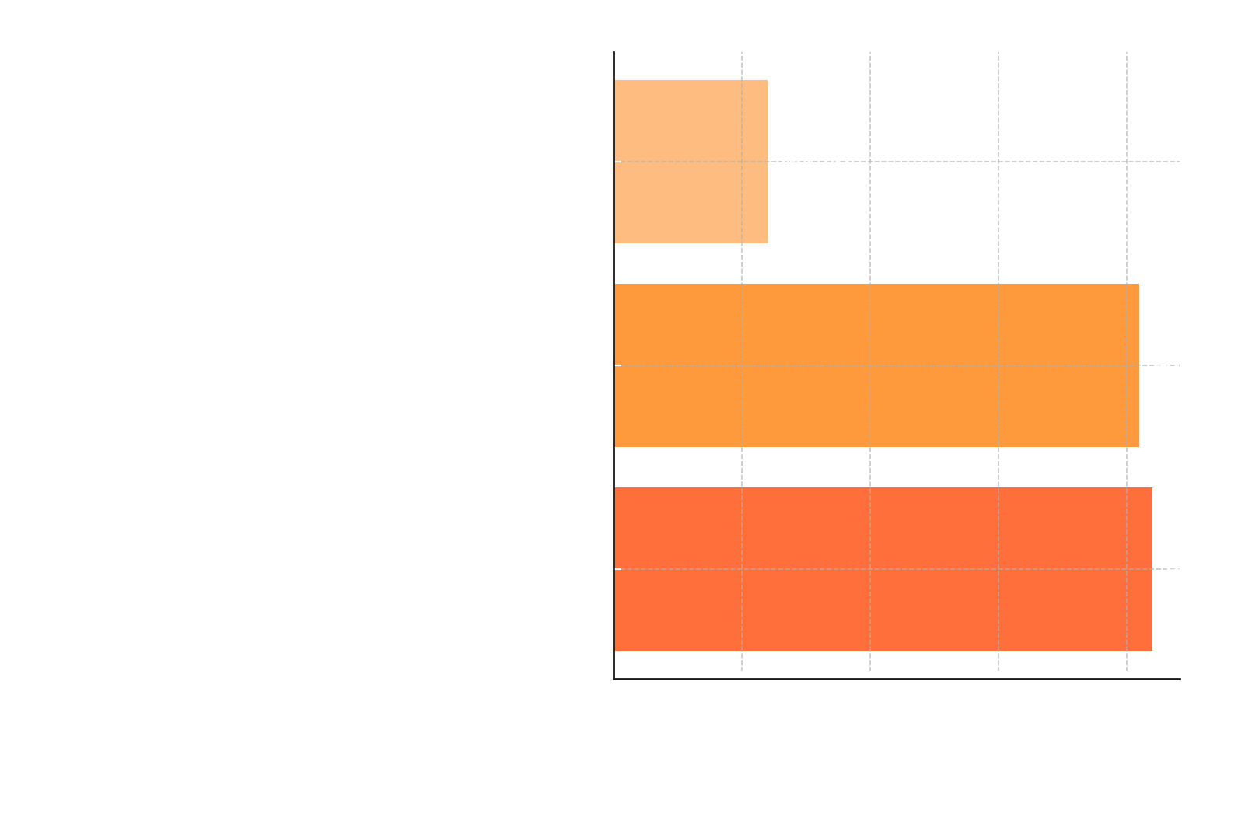
Effect
Notes:
Beneficiaries:
older and less tech-savvy people who struggle to spot scams.
Success Metric:
Number of phishing attempts detected & blocked.
User adoption in the community (downloads, active users).
Scalability:
Expand training & safe practice to more languages and regions.

Slide 4
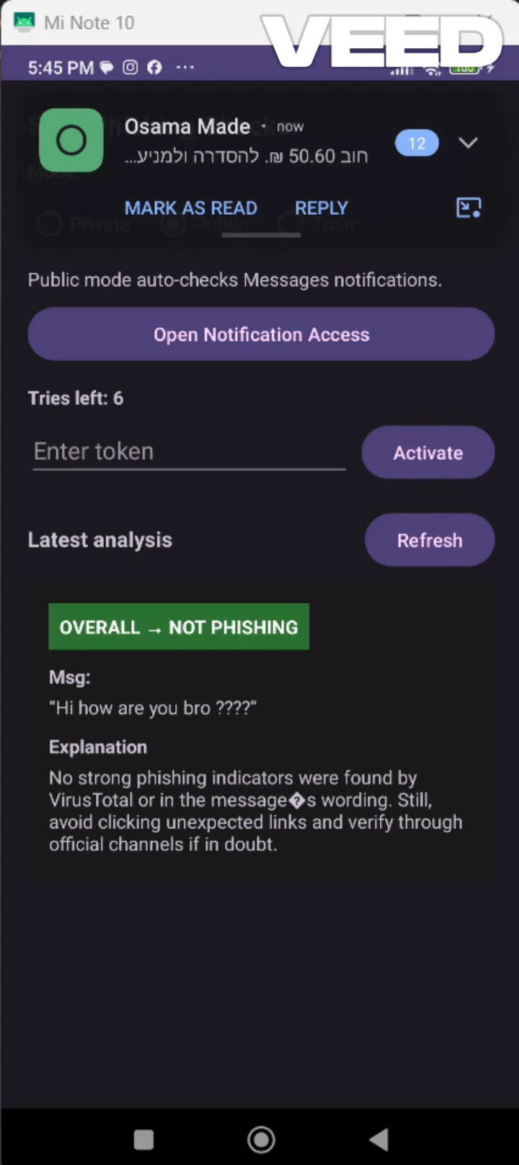
Our Solution
Monitor Notifications
Analyze Content
Capture and scan in real time
Check text and links
User Training Mode
interactive tips to help users spot phishing themselves (planned feature)

Slide 5
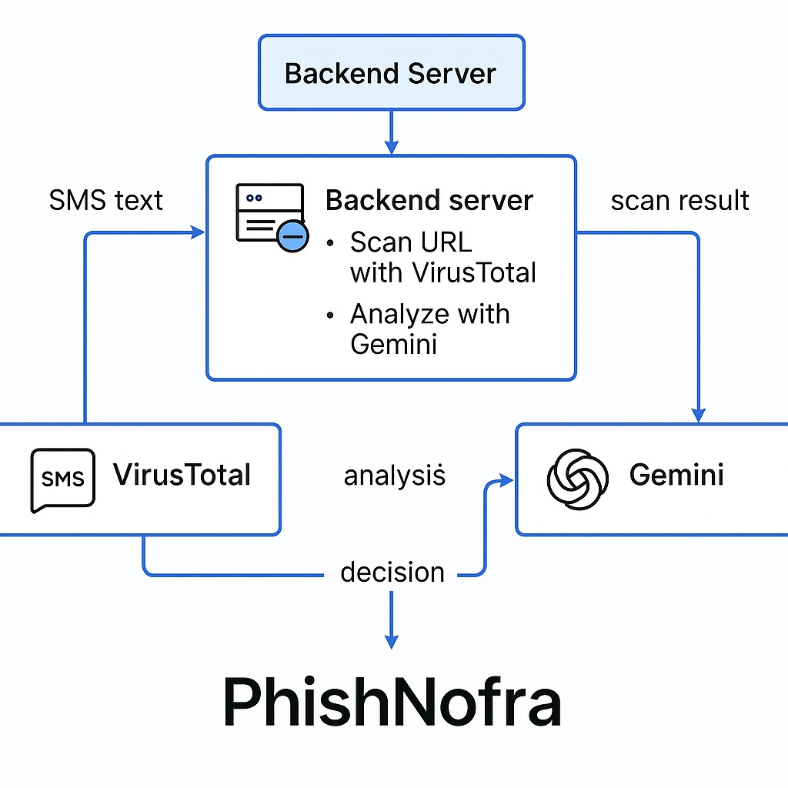

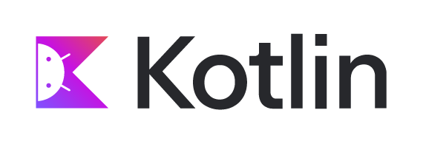


Tech Stack

Slide 6
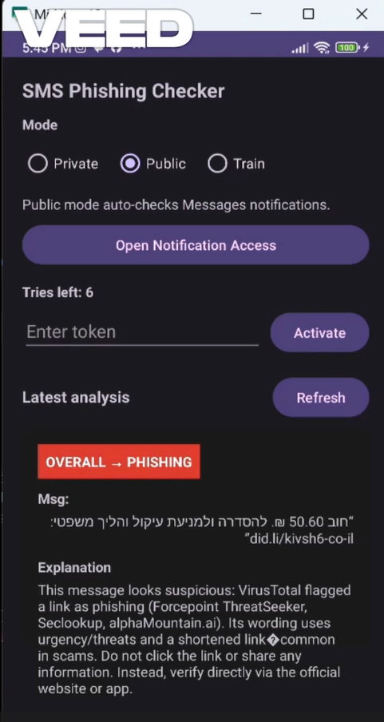
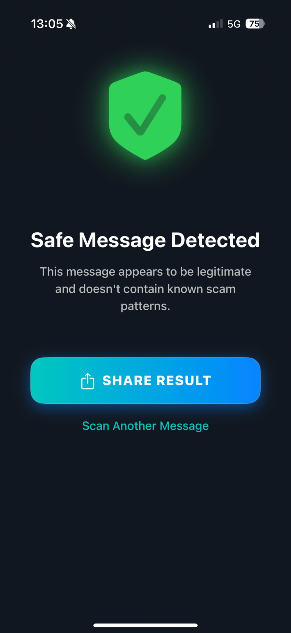


Competitors - Fishy app result on Kvish 6

Slide 7

Why us ?
Dual Detection — Text & links, not just URLs
Local Languages — Arabic & Hebrew support
Flexible Modes — Auto real-time or manual check
User Empowerment — Training & phishing simulations

Slide 8
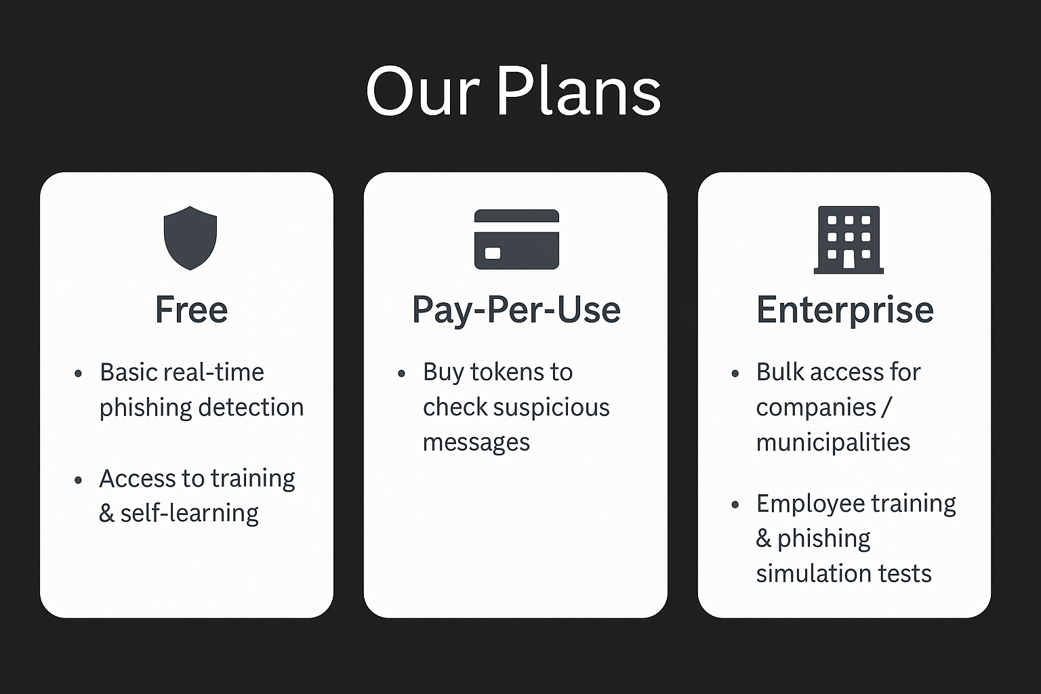
Business Model

Slide 9
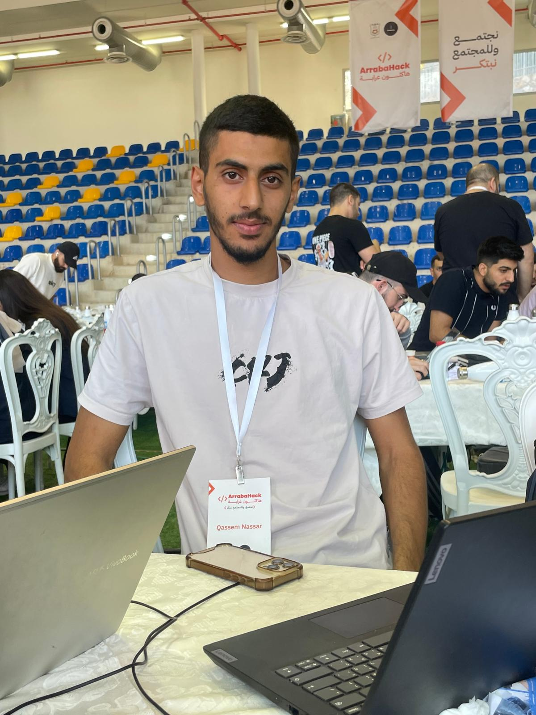
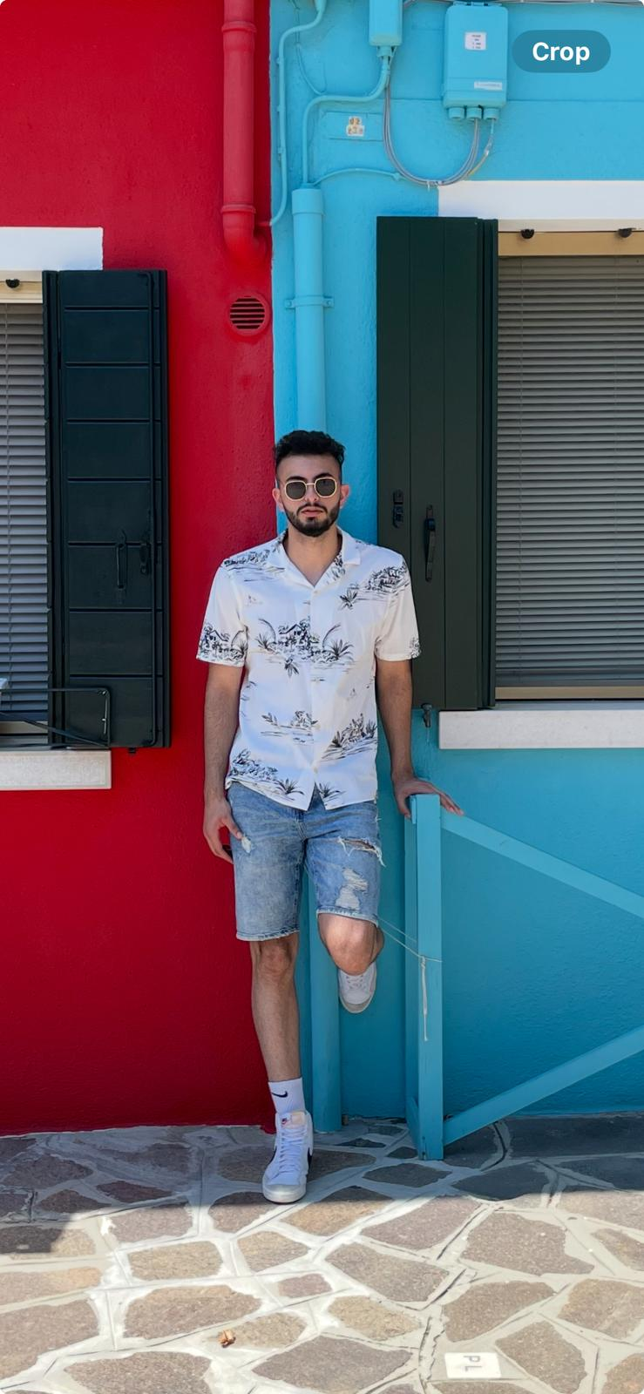
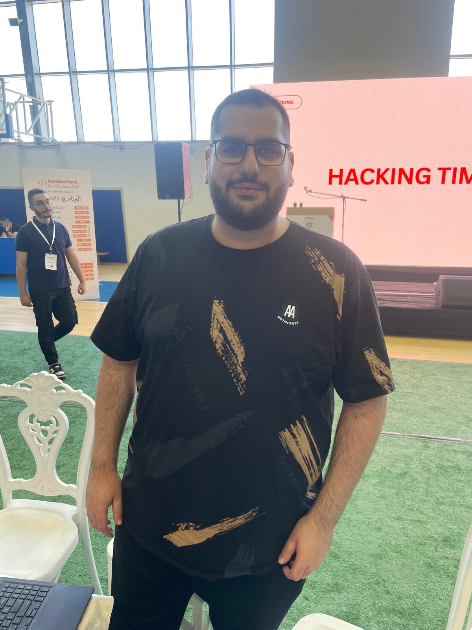
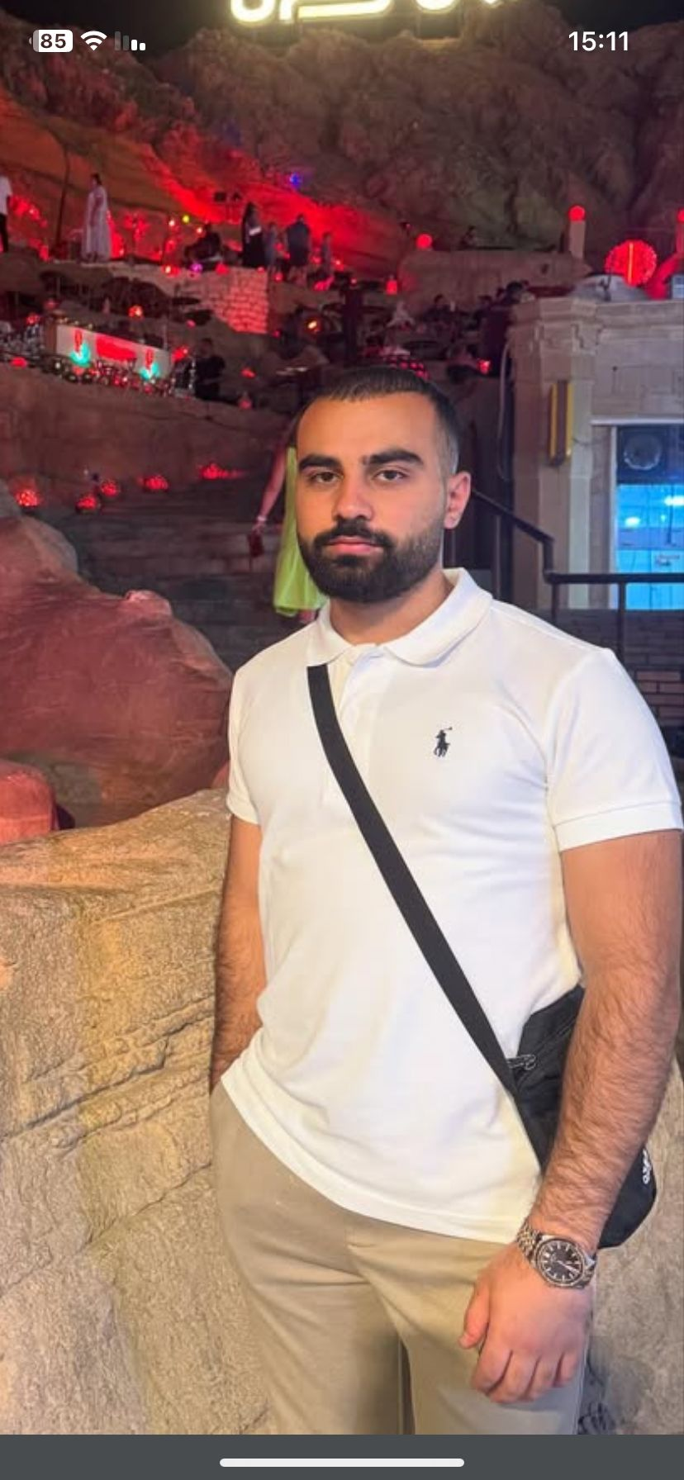
Our Team
“Tech + Design + Strategy — united to fight phishing.”
Qassem Nasar
Wadiea Frann
Ibrahim Asad
Osama Madi
Product Owner
UI/UX Designer
Backend Developer
Team Leader

Slide 10
Join Us in Building Safer Mobile Experiences
Contact us: ibrahim05082955@gmail.com
osamamadi43@gmail.com
repo : https://github.com/IbrahimAsad421/ArabaHack.git

